Slide 1
Malaria Detection
- By Nishad Khudabux
Notes:
Mic Check
Thank you for being here
My name
Lets jump right in

Slide 2
Problem Summary
Early Detection Is Key
Disease Of Poverty
Diagnostic Tools
Malaria is a contagious disease caused by bites from infected mosquitoes.
Late treatment can cause complications and can even be fatal.
Despite effective treatments there where 672 thousand malaria related deaths in 2020.
95% of cases in Africa alone.
Microscopy
Accurate
Expensive
Less Available
Rapid Diagnostic Test
Less Accurate
Less Expensive
More Available
Need scalability for 241M case (2020)
Notes:
TO GIVE SOME CONTEXT
SYMPTOMS CAN MIMIC FLU AND LIE DORMANT
DESPITE GOOD TREATMENT AND DETECTION

Slide 3
Solution
Using a convolutional neural network (CNN) for accurate detection at a lower cost.
Automated Computer Vision System
Notes:
LEVERAGING COMPUTER VISION FOR GREATER ACCURACY AT A LOWER COST

Slide 4
Solution Design
Notes:
LET'S TAKE A LOOK AT WHAT THAT MIGHT LOOK LIKE

Slide 5
Goals
Surpases
Rapid Diagnostic Tests (RDTs)
(~88% accuracy)
Matches
Microscopy
(~98% accuracy)
+
High Recall Score
(Low # of False Negatives)
Build A Model That

Slide 6
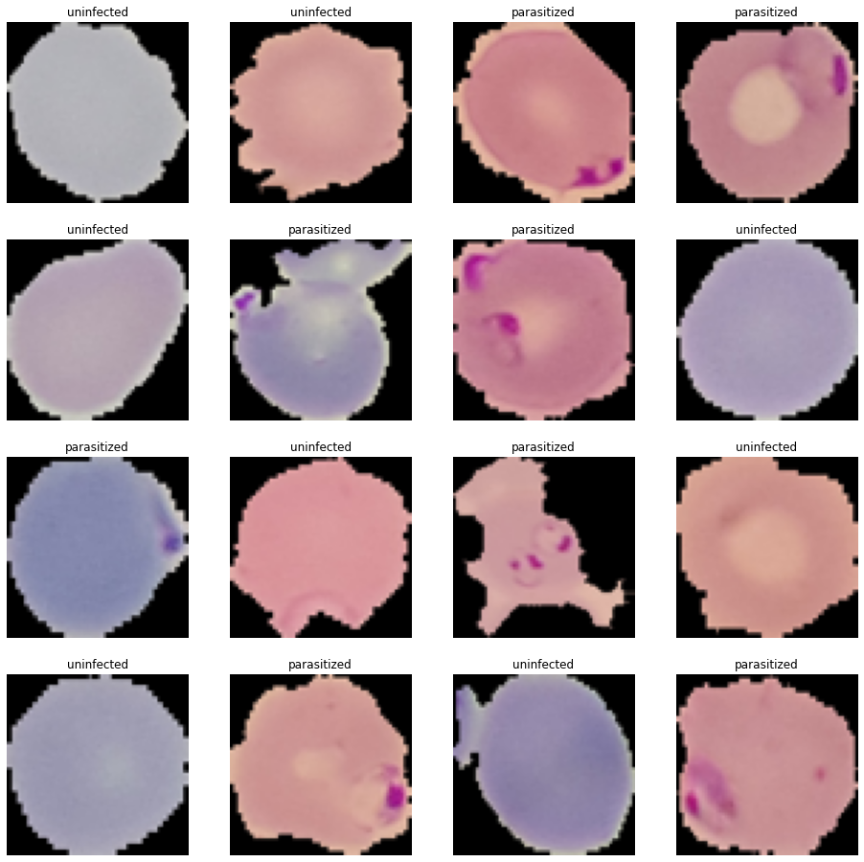
Model Development Process
No simple code based solutions, requires computer vision.
98.35% test accuracy
Hard to improve
Worth trying for scale and impact
Tuning to find optimal combination of hyperparameters.
Simple Solution?
ANN vs CNN
Base Model
Variations
Model_2o
EDA showed shape and position as key characteristics.
5 variations of CNN models tested. Model_2 showed highest efficacy.
Notes:
BE BRIEF THIS IS TECHNICAL ONLY
229M CASES AT 2% = 4.5M EVERY PERCENT COUNTS
SQUEEZE EVERY BIT OF JUICE OUT OF THE ROCK
NOTES
Base Model
Scale: Applying to 229M cases 2% = 4.5M
Impact: Medical test (higher standards) potential for fatalities
Variations
Variations: loss functions (binary CE + categorical CE), complexity, activation function, data augmentation, transfer learning
Model_2 = increase complexity
Model_2o = LeakyRelu + batch size 16 + 32|32|32|64

Slide 7
Model_2o
Model_2o Confusion Matrix
1286
98.92%
14
1.08%
Uninfected
20
1.54%
1280
98.46%
False Positives
False Negatives
Parasitized
Uninfected
Parasitized
F1-score 98.69%
Notes:
FOCUS ON PERCENTAGES
OVERALL SCORE OF 98.69%
False Negatives = Recall

Slide 8

Model_2o
Surpases
Rapid Diagnostic Tests (RDTs)
(~88% accuracy)
Matches
Microscopy
(~98% accuracy)
+
High Recall Score
(Low # of False Negatives)
98.69% Accuracy
No Overfitting
Generalizes Well
Notes:
OVERALL A GREAT OUTCOME

Slide 9
Implementation

Slide 10
Frugal Solutions
(2020)
241M cases
95% in Africa
Minimize Cost
"It can’t cost a ton of money because every zero that you add to the cost of scientific equipment, probably.. millions and billions of people are cut off"
Manu Prakash
Notes:
KEEP BACK OF MIND
NOTES
2000 cases in United States, case for lack of experience.
241 million cases and 672 thousand deaths, USE CASE in the developing world

Slide 11
Deployment - Cloud vs Edge
Cloud Based System
Edge Based System
Load the model online to be accessed through internet.
Load and receive remotely
No additional equipment
Easy to update the model
High cost of providing satellite internet service to each technician (~20-50$/month)
Load the model on hardware (edge chips)
No internet needed for rural areas
Less overall cost (5-100$/unit)
Potentially need to replace broken or old units
Difficult to update the model
Notes:
KEY DECISION HOW TO DEPLOY
CLOUD COST => SATELLITE INTERNET
EDGE COST => HARDWARE
NOTES
Not entirely clear which is best, rough pricing would favor chips but need more information
Do the technicians already have access to internet as part of their work?
Do the technicians already have access to capable computing as part of their work?
Is an option cheaper in non rural areas and what percent of that is within our scope of work?
How sustainable are both systems?

Slide 12
Cost Benefit Analysis
Scalability
Cost Of Automated System
Cost Of Traditional Methods
Implementing and Maintaining Model
10-30K + 9k/year
=75K over 5 years
Cost of Cloud System
Ave 35$/month x 1500 tech.
=3.15M over 5 years
Total
3.23M over 5 years
Cost of Testing (USA)
RDT 2.19$ USD
(labour + materials)
Microscopy 6.98$ USD
(labour + materials)
# of Cases in Africa (2020)
95% of 241M = 229M
Total (RDT*Cases)
501M per year
erred to
more expensive estimates
erred to less expensive estimates
Notes:
All cases erred towards traditional methods
Rough estimations, but given the orders of magnitude of separation, likely no hidden factors that would bridge that gap
DEFINITELY WORTH THINKING ABOUT THIS KIND OF SYSTEM

Slide 13
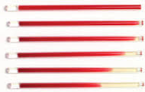
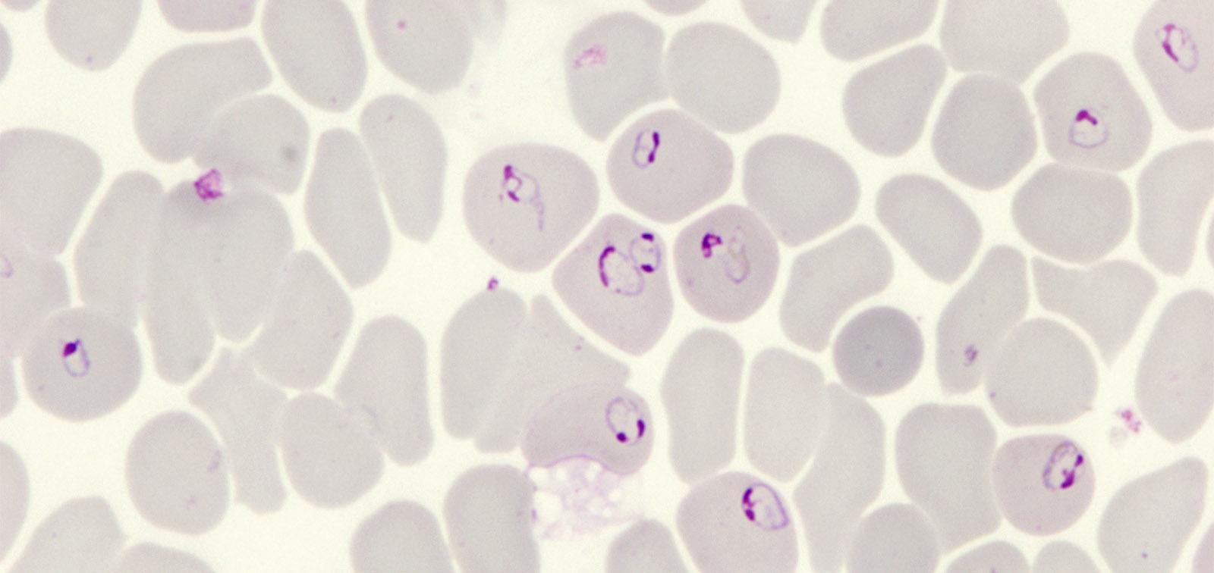
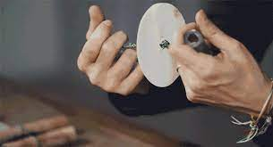
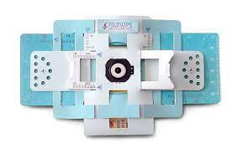
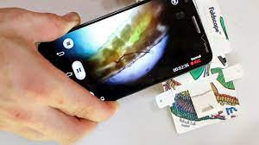
Implementing An Automated System
1
5
Blood Sample
Sample Image
2
6
Paperfuge
Segmentation Program
3
7
Foldscope
Our Model
4
8
9
10
Smart Phone
Aggregate Program
Diagnosis
Treatment
Notes:
Our model is only one part of the potential automated system required to diagnose and treat.
Since 1 blood sample is likely to contain multiple infected cells, the aggregation process would likely mitigate our 1% error

Slide 14
Risk and Challenges
Our model detects if a patient is infected not type or severity. There is a risk of not recognizing a severe case and not responding with the correct urgency.
Should be periodically checked to ensure it is functioning properly. A new strain or changes to collecting samples requires us to update our model.
Difficulty using a new digital tool and potential rejection from fear of the unknown.
Urgency and Changes
+
Learning curve
Notes:
Goal of self sufficiency (education + patience)

Slide 15
Recommendations
Step 1
Step 2
Step 3
Automated System
Our models efficacy suggests it is ready to be implemented.
What is missing is the surrounding systems our model would work within.
Analysis
Our rough estimates show viability, but implementation requires more detailed analysis.
Reaching out to already established organizations.
Test Case
Small scale initially to test the system and work out bugs. Can easily be scale up once established.
Notes:
BUILD OUT THE SYSTEM THAT OUR MODEL FITS INTO

Slide 16
Thank You
Notes:
WANTED TO SAY THANK YOU AGAIN AND OPEN IT UP TO Q&A

Slide 17
Q and A

Slide 18
Appendix

Slide 19
Model Comparison
Model | Description | Test Accuracy
Model_0 | Base model (given) | 98.35%
Model_1 | Change from binary_crossentropy to categorical cross_entropy | 97.85%↑
Model_2 | Added 4rth layer (64 filters) | 98.07%↑
Model_3 | Change to LeakyRelu and added Batch Normalization Layers | 96.23%↓
Model_4 | Data Augmentation | 97.73%↓
Model_5 | Transfer Learning (VGG16) | 92.69%↓
Model_2o | Optimizing our best model by testing multiple micro-adjustments. | 98.69%↑

Slide 20
Dataset Images

Slide 21
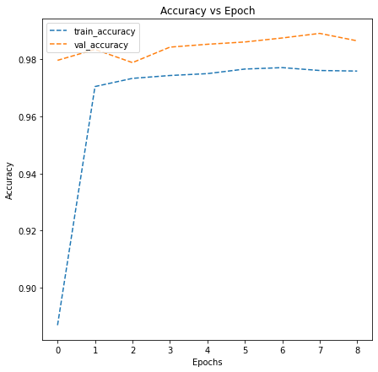
Training/Validation Plot

Slide 22
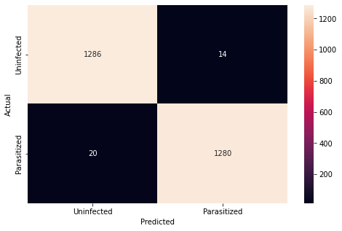
Confusion Matrix

Slide 23
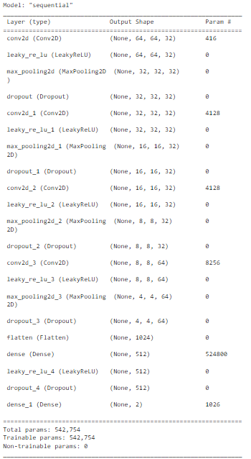
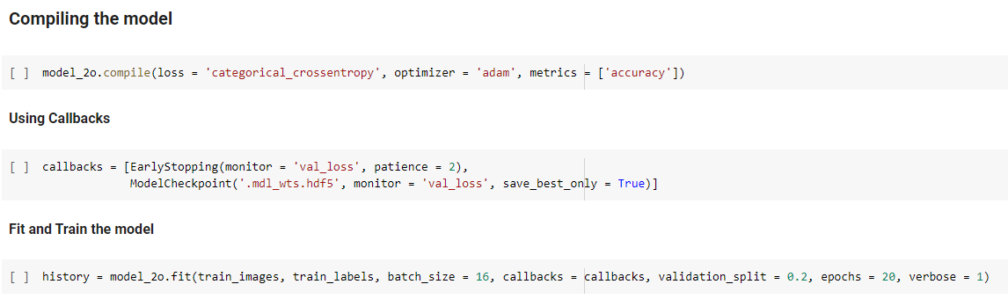

Model_2o Architecture and Accuracy

Slide 24
Note on Latency
Latency in this case study is not a relevant factor, compared to for example computer vision in self-driving cars where increased computation time can result in an accident. While we can run a machine-learning model on a database of malaria samples for many hours with no consequences. For that reason, the model compilation time is observed in the notebook, but it will be excluded here.

